Slide 1
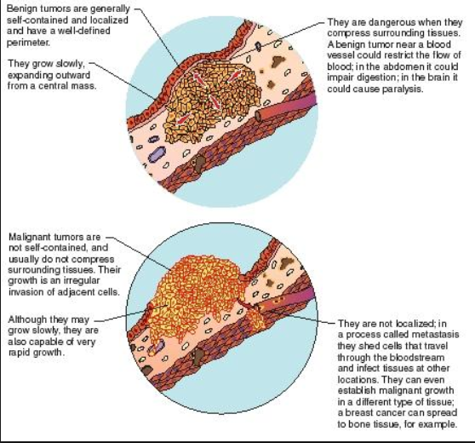
Breast Cancer Survival Data Analysis
Exploratory Data Analysis
Term 1 – Project
By – Diwjen Philixon(diwjenp@gmail.com

Slide 2
1. Introduction.
2. Problem Statement.
3. Data Profiling & Analysis through questions
5. Conclusion
AGENDA

Slide 3
1. Introduction
In the Exploratory Data Analysis we are using Python skills on a structured data set including loading, inspecting, wrangling, exploring, and drawing conclusions from data.
The notebook has observations with each step in order to explain thoroughly how to approach the data set. Based on the observation some questions also are answered in the notebook for the reference though not all of them are explored in the analysis.

Slide 4
2. Problem Statement
Aim is to study survival rate of patients who had undergone surgery for breast cancer during the period 1958- 1969 .

Slide 5
3. Data Profiling & Analysis through questions
How balanced is the dataset ?
Finding the best feature for the classification of the survival status?
Finding the co-relationship between the columns?
How many patients survived.

Slide 6

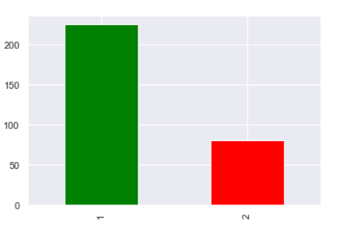
4.1. How balanced is the dataset ?
The dataset is imbalanced with 75% of data points belonging to survival class and 25% belonging to the dead class.

Slide 7
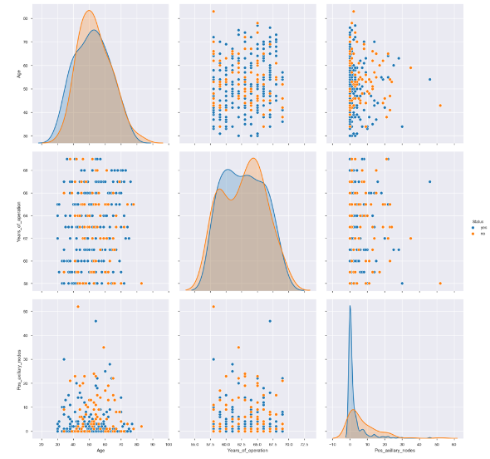
4.2. Finding the best feature for the classification of the survival status?
From the graph we can observe, large number of operation were done in span of 7 years between 1960 and 1966.
Irrespective of the Age patients with 0 nodes have survived.

Slide 8
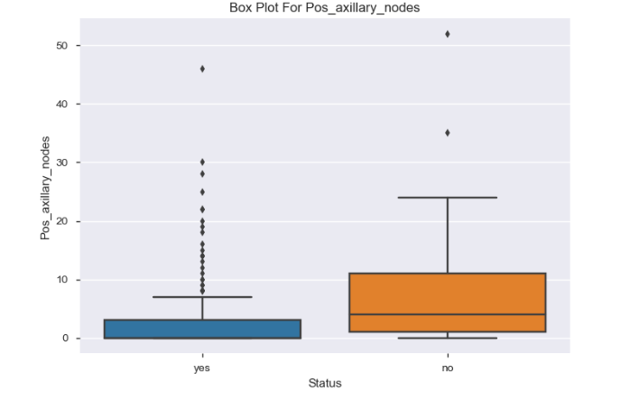
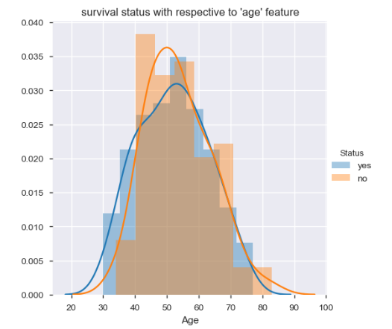
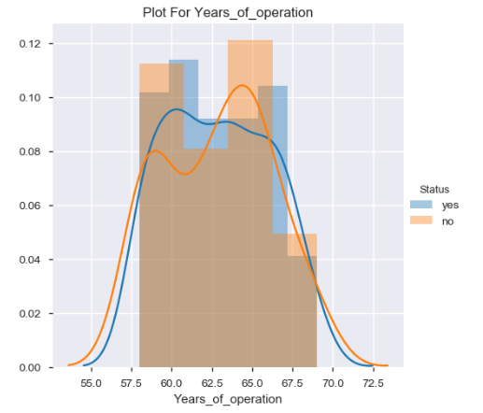
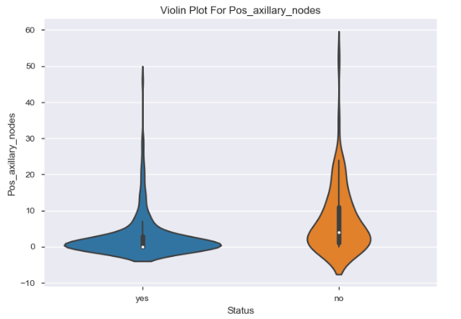
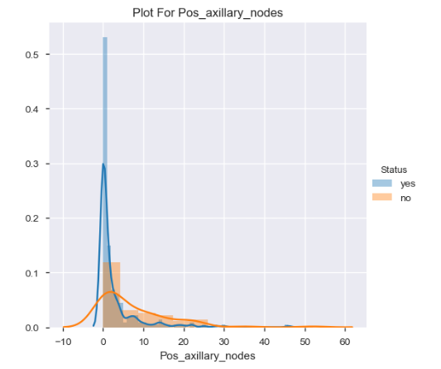
4.3 How many patient survived/ Dead?
Large number of patients died whose operation was done in year 60 and 65.
Overlapping age from 40-60 are more likely to die.

Slide 9
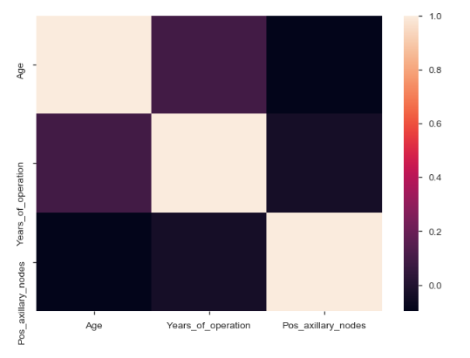
4.4.Finding the co-relationship between the columns?
Correlation between Age & Pos_axillary node is below 0 and more trending towards negative due to the fact that more number of positive auxiliary nodes refer that the patient has not survived.

Slide 10
5. Conclusion
Survey was conducted to find the survival rate of the patients suffering from Breast Cancer.
Pos_axillary_nodes is the most informative feature with respect to the output level we are predicting here, and hence has most importance (or weightage) than the remaining ones.
Data analysis was done during the period 1958 - 1969 to find the survival rates.
Total number of 306 patient samples were taken out of which 225 survived i.e 75% of the data samples.
While 81 patients i.e. 25% did not survived from the total samples taken.
75% of the patients have less than or equal to 5 Pos_axillary_ nodes.
From the analysis we can conclude the patients treated after 1966 have slightly higher chance to survive than the rest. The patients treated before 1959 have the slightly lower chance to survive that the rest.
If number of axillary node is less, than survival of patients is more.

Slide 11
Thank You

